Slide 1
JIT Frontend Bootcamp
Karol Kowalczuk, Łukasz Wiśniewski
January 2018

Slide 2
Agenda
Javascript basics
Development tools
Introduction to react.js
React.js – (more) advanced concepts
App state management with redux
Advanced debugging techniques and testing*

Slide 3
JavaScript basics
1
JavaScript is a single-threaded scripting programming language.
OOP? Functional programming?
Why not both?!

Slide 4
JavaScript basics
2
Execution Environments
Web
Non-web
Both client- (interpreted compiled by browsers to CLR nowadays) and server-side (executed by node.js environment)
Embedded scripting language (e.g. browsers extensions)
General purpose scripting language
Used as an application platform
Notes:
Wypadałoby wspomnieć o V8 – zarówno Chrome jak i node.js korzystają z tego silnika. Implementuje specyfikację ECMAScript i kompiluje kod źródłowy skryptów do pośredniego języka maszynowego. Dba o alokacje pamięci, garbage collecting; wprowadza dodatkowe optymalizacje niemożliwe w przypadku podejścia interpretowanego.

Slide 5
JavaScript basics
3
Creating objects directly from other objects
Behaviour delegation
Composability
Extending objects dynamically
Tightly couples base class with inherited ones
Must know the desired properties of inherited object before instantiation
OLOO* („can do”)
Inheritance („is a”)
* objects-linked-to-other-objects
Notes:
“The problem with object-oriented languages is they’ve got all this implicit environment that they carry around with them. You wanted a banana but what you got was a gorilla holding the banana and the entire jungle.”
~Joe Armstrong

Slide 6
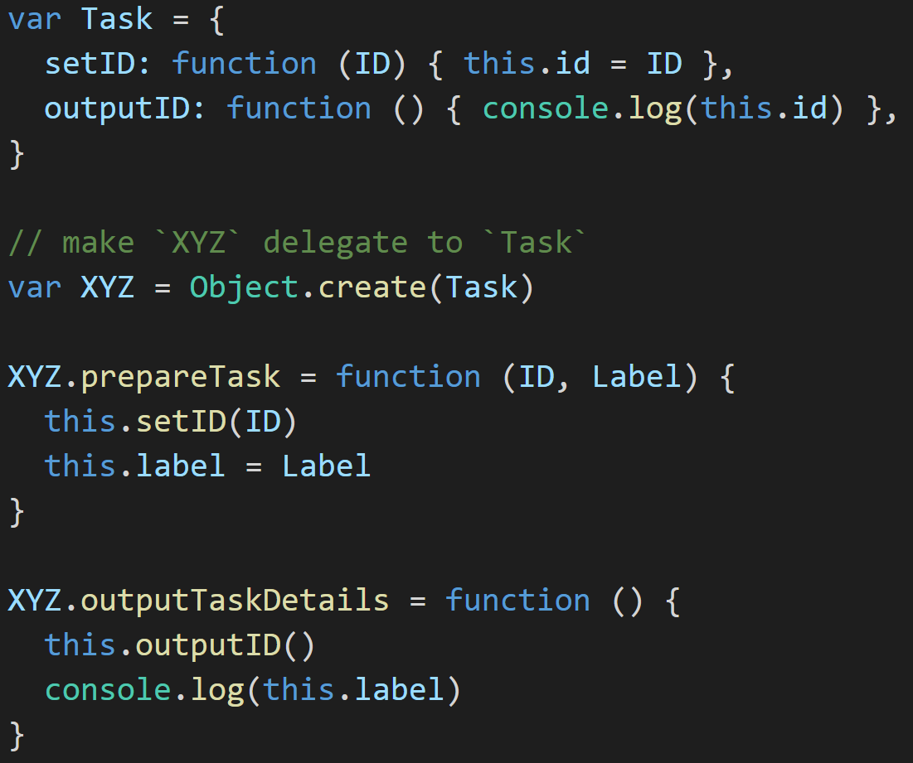
JavaScript basics
4
Behaviour delegation
Include a utility method if needed
Credits to: Kyle Simpson

Slide 7
JavaScript basics
5
Functional programming
Pure functions
No shared state
Given the same input always gives the same output; makes composition easy as pie
Do not pass the properties of the object between scopes
No state mutations
No side effects
Allows to track the transfomations and do time-traveling
Just be deterministic

Slide 8
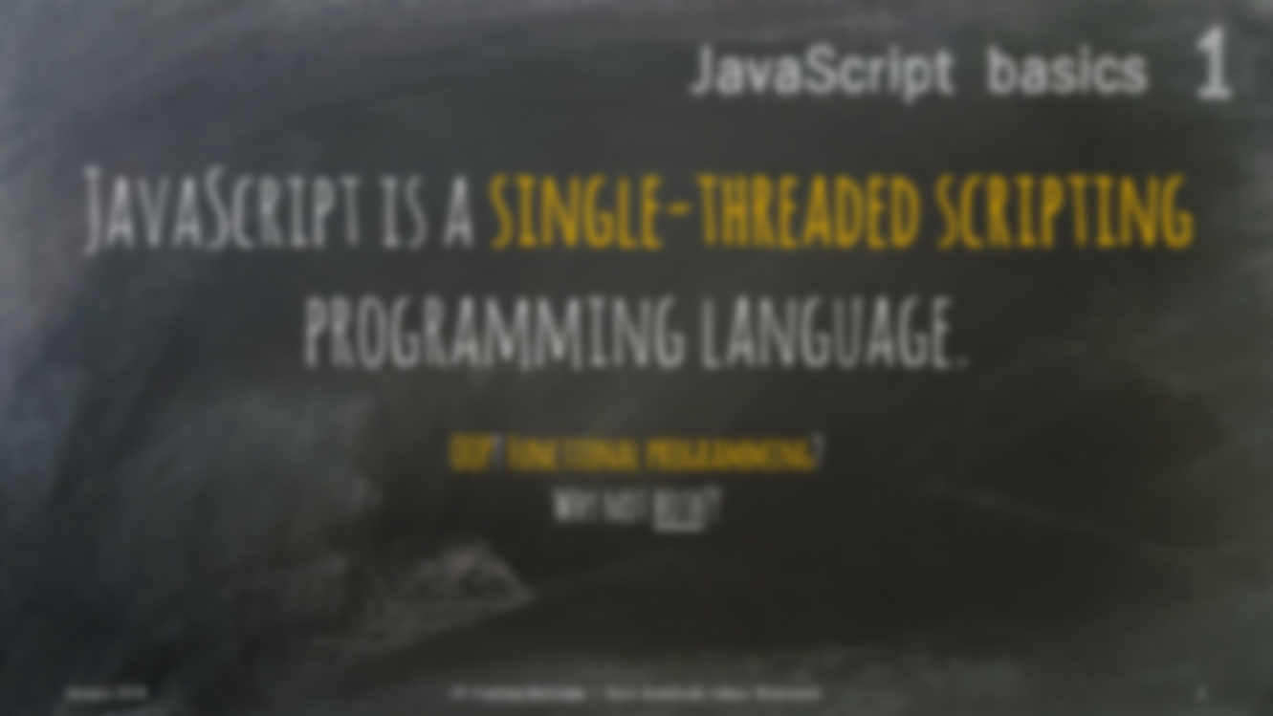

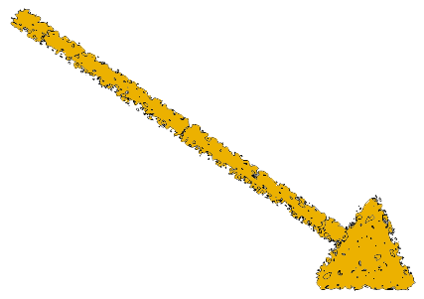
JavaScript basics
6
Asynchronous calls
Wait, what?

Slide 9
JavaScript basics
7
one thread == one stack == one thing at a time
except not really.
Notes:
JS Runtime jest jedno-threadowy, ale nie zapominajmy że przeglądarka to nie tylko Runtime.

Slide 10
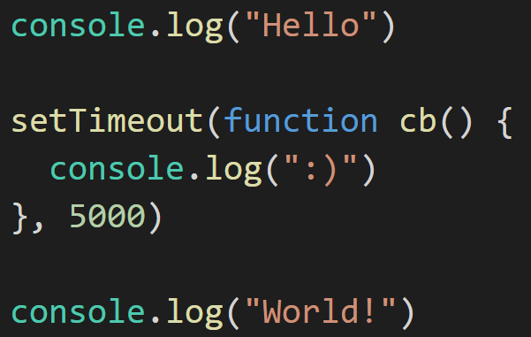

JavaScript basics
8
stack
threads (WebAPIs)
console
event loop
tasks queue

Slide 11
JavaScript basics
8
stack
threads (WebAPIs)
main()
console
event loop
tasks queue

Slide 12
JavaScript basics
8
stack
threads (WebAPIs)
log(”Hello”)
main()
console
Hello
event loop
tasks queue

Slide 13
JavaScript basics
8
stack
threads (WebAPIs)
main()
console
Hello
event loop
tasks queue

Slide 14
JavaScript basics
8
stack
threads (WebAPIs)
setTimeout(cb)
main()
console
Hello
event loop
tasks queue

Slide 15

JavaScript basics
8
stack
threads (WebAPIs)
timer
cb
setTimeout(cb)
main()
console
Hello
event loop
tasks queue

Slide 16
JavaScript basics
8
stack
threads (WebAPIs)
timer
cb
main()
console
Hello
event loop
tasks queue

Slide 17
JavaScript basics
8
stack
threads (WebAPIs)
timer
cb
log(”World”)
main()
console
Hello
World
event loop
tasks queue

Slide 18
JavaScript basics
8
stack
threads (WebAPIs)
timer
cb
main()
console
Hello
World
event loop
tasks queue

Slide 19
JavaScript basics
8
stack
threads (WebAPIs)
timer
cb
console
Hello
World
event loop
tasks queue

Slide 20
JavaScript basics
8
stack
threads (WebAPIs)
console
Hello
World
event loop
tasks queue
cb

Slide 21
JavaScript basics
8
stack
threads (WebAPIs)
cb
console
Hello
World
event loop
tasks queue
Notes:
Event loop – patrzy na stos, jak jest pusty, wrzuca na niego po kolei zadania z task queue

Slide 22
JavaScript basics
8
stack
threads (WebAPIs)
log(”:)”)
cb
console
Hello
World
:)
event loop
tasks queue
Notes:
Event loop – patrzy na stos, jak jest pusty, wrzuca na niego po kolei zadania z task queue

Slide 23
JavaScript basics
8
stack
threads (WebAPIs)
cb
console
Hello
World
:)
event loop
tasks queue
Notes:
Event loop – patrzy na stos, jak jest pusty, wrzuca na niego po kolei zadania z task queue

Slide 24
JavaScript basics
8
stack
threads (WebAPIs)
console
Hello
World
:)
event loop
tasks queue
Notes:
Event loop – patrzy na stos, jak jest pusty, wrzuca na niego po kolei zadania z task queue

Slide 25
JavaScript basics
9
XHR*
Promises
Fetch API
Since 1999
Officially since 2012
Since 2015 (Chrome v40+)
Registering callbacks for particular events (onload, onerror)
Objects representing async actions result; there are three different states of Promises: fulfilled, rejected, pending
Wraps HTTP requests with a Promise; still not widely supported by browsers
* XMLHttpRequest
Notes:
At their most basic, promises are a bit like event listeners except:
A promise can only succeed or fail once. It cannot succeed or fail twice, neither can it switch from success to failure or vice versa.
If a promise has succeeded or failed and you later add a success/failure callback, the correct callback will be called, even though the event took place earlier.

Slide 26
Introduction to react.js
1
React.js is not a framework. It is
only a view library.

Slide 27
Introduction to react.js
2
No controllers
No digest loops
No directives
No view models
Just Components.
In react.js world every rendered block is a component.

Slide 28
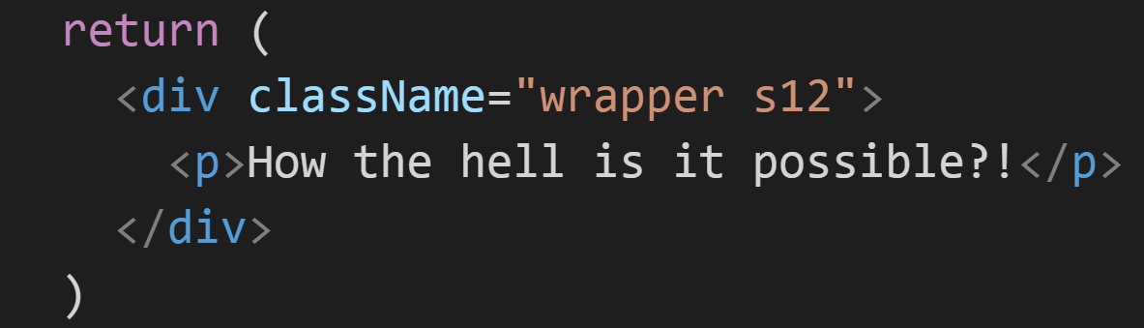
Introduction to react.js
3
JSX
xml-like syntax extension for EcmaScript
HTML!?

Slide 29
Introduction to react.js
4
Separation of concerns components
(only) if they are designed and built as self-contained entities.
Composability and flexibility
Reusability
Maintainability
Ability to be tested independently

